Slide 1

Shaken Baby Syndrome or
Abusive Head Trauma
Presenter Information and/or Additional Information
Supported in part by ALH21MC06738 from the Department of Health and Human Services Health Resources and Services Administration, Maternal and Child Health Bureau. The contents are the sole responsibility of the authors and do not necessarily represent the official views of DHHS.

Slide 2
Traumatic Brain Injury (TBI) Defined⁴
TBI: “an alteration in brain function, or other evidence of brain pathology, caused by an external force”
(Strokes, aneurisms, etc.
are examples of internal trauma)
Closed TBI : brain is damaged without penetrating skull
(Most common & results from falls, car accidents, assault, etc.)
Open TBI : skull penetrated by an external object
(i.e. gun shot wound)
Notes:
4 “BIAA Adopts New TBI Definition”. www.biausa.org. Feb 6 2011.

Slide 3
Traumatic Brain Injury is…
Injury to the head from a blunt or penetrating object
Injury from rapid movement of the head that causes back and forth movement inside the skull
Notes:
Head Injury: Employment Challenges MC Ret. 111011
Traumatic brain injury, or TBI, results from
- a blow to the head of sufficient force to create blunt trauma, such as being hit in the head with a baseball bat or having one’s head slammed against a hard object,
- the result of trauma secondary to a penetrating object into the brain itself, for example, a bullet entering the brain.
-the result of rapid movement of the brain within the skull, e.g., shaken baby syndrome, or repetitive shaking of the body/head.

Slide 4
Mild TBI/Concussion
Facts
Common Symptoms
Defined as a period of altered mental state or a brief loss of consciousness (LOC) following a blow to the head
80-85% of all TBIs are mild
Often is undiagnosed, misdiagnosed
Family and individual are seldom followed by medical community or receives education in the ER
May or may not lose consciousness
Headaches
Dizziness
Slowed processing
Forgetfulness
Fatigue
Sensitivity to noise and lights
Altered sleep pattern
Notes:
Head Injury: The Hidden Challenge/TBI 101 MC 12711
Symptoms are related to adolescents to adults; not infacts and young children.

Slide 5
Moderate TBI
Severe TBI
LOC can last from minutes to hours
May have tissue damage, bleeding or fractures in skull
Symptoms may include loss of recall of the event, confusion, and impaired verbal memory
LOC for 6 or more hours
Long –Term disability is highly likely
Behavior, social, and communication impairments may result
15-20% of TBIs are moderate to severe in nature
Documented loss of consciousness
Potential skull fractures
Significant period (days to weeks) of coma
Significant loss of information for a period of time post event
Significant and chronic thinking, physical and emotional changes
Notes:
Symptoms are related to adolescents to adults; not infacts and young children.

Slide 6

Some Long Term Effects of TBI
Neuromedical
Headaches, Poor Balance, Change in taste/smell/hearing, Pain Issues, Seizures, Sleep Disturbance,
Behavioral-Emotional
Irritability, Depression, Lack of motivation, Desocialization, Impulsivity, Loss of emotional control
Communication
Poor listening and conversational skills, Word-retrieval problems, Speech Impairment
Cognitive
Memory difficulties, Impaired concentration, Slow mental processing, Loss of judgment
Extracted from “Post-Concussive Symptomatology Checklist” by Comp. Head Injury Center-National and ADRS
Notes:
Symptoms are related to adolescents to adults; not infacts and young children.

Slide 7
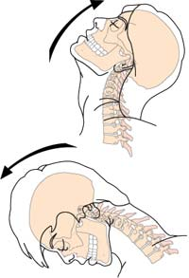
What happens when the brain is injured?
Primary Injury
Direct movement of the brain inside skull (slamming, rubbing, shearing)
Penetrating object
Secondary Injury
Bleeding over and within the brain tissue
Swelling from fluid leakage
(increased intracranial pressure)
Ex. Diffuse Axonal Injury

Slide 8
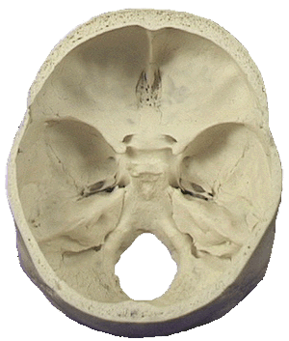
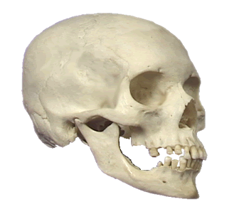
Skull Anatomy
The base of the skull is rough, with many bony protuberances.
These ridges can result in injury to the temporal and frontal lobes of the brain during rapid acceleration.
The skull is a rounded layer of bone designed to protect the brain from penetrating injuries.
Bony ridges
Notes:
Reference unknown (HC 11.20.11)

Slide 9
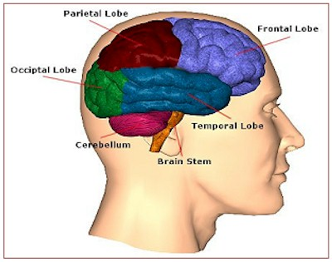
View of the Brain
Frontal Lobe:
Executive Function (Attention, Judgment, Organization, etc.)
Parietal Lobe:
Visual, Spatial Orientation
Occipital Lobe:
Vision
Temporal Lobe:
Hearing, Memory
Cerebellum:
Balance, Coordination
Brain Stem:
Regulation, Consciousness,
Involuntary Activities

Slide 10
Who is at risk?
Estimated 1.7 million injuries annually ¹
Males have a higher incident rate (~75%) than females.³
Ages most at risk:
0 to 4 years; 15 to 19 years; and 65 years and older ¹
Notes:
Faul M, Xu L, Wald MM, Coronado VG. Traumatic brain injury in the United States: emergency department visits, hospitalizations, and deaths. Atlanta (GA): Centers for Disease Control and Prevention, National Center for Injury Prevention and Control; 2010
3 "Traumatic Brain Injury Model Systems National Database Update". Traumatic Brain Injury Model Systems National Data and Statistical Center. www.tbindsc.org. 2011.

Slide 11
Leading Causes of TBI ^{1*}
*Based of CDC’s annual estimates from 2002-2006
Notes:
1 Faul M, Xu L, Wald MM, Coronado VG. Traumatic brain injury in the United States: emergency department visits, hospitalizations, and deaths. Atlanta (GA): Centers for Disease Control and Prevention, National Center for Injury Prevention and Control; 2010 .
Examples of Causes:
Motor vehicle crashes
Blow to the head with any object
Strenuous shaking of body
Acceleration/Deceleration
Falling and hitting head
Body contact-sports
Strangulation
Being pushed against wall/solid objects
Blasts
Use of firearms
Near drowning

Slide 12
What Is Shaken Baby Syndrome?
Shaken Baby Syndrome (SBS) is a violent form of child abuse.
Now being referred to as Abusive Head Trauma (AHT) or Inflicted Traumatic Brain Injury (ITBI)
It occurs when an infant or small child is forcefully shaken, creating a ‘whiplash’ type injury
Babies under 1 year of age are at a high risk with 2 to 4 month old babies being at the greatest risk
Approximately 1200 to 1400 cases of AHT occur annually in the US.
The 75% that survive experience serious consequences from the injuries.
Leading cause of child abuse deaths in US
1 in 4 children who are victims of AHT die.

Slide 13

Who Shakes a Baby?
Fifty percent (50%) of offenders are natural parents.
Seventeen percent (17%) are non-relatives.
Seventeen percent (17%) are the mother’s boyfriend.
Six percent (6%) are step-parents and 10% are in the “other” category.
Almost 80% of offenders are male.
Approximately 60% of AHT victims are male.

Slide 14
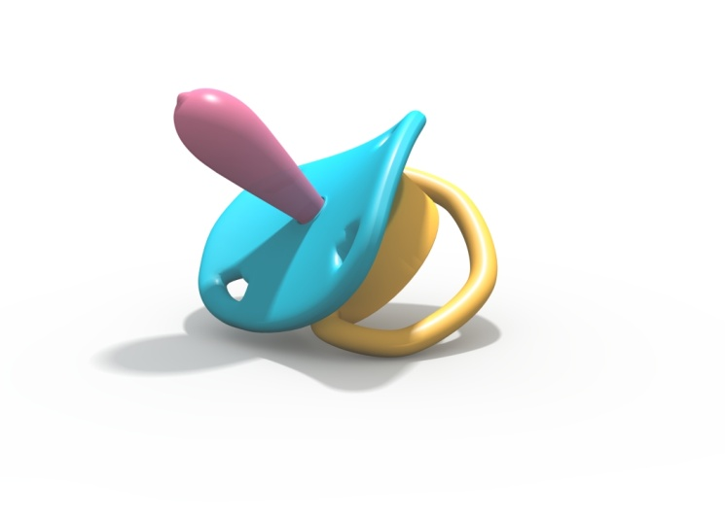
Why Do Caregivers Shake A Baby?
The primary trigger for shaking a baby is continuous or inconsolable crying.
Caregivers become angry or extremely frustrated with a baby’s fussiness or crying and cannot deal with the stress or frustration.
Other issues that may increase potential shaking include being “stressed out”, involved in domestic violence, abuse of drugs and/or alcohol.
Anyone who is frustrated with a crying, fussy baby is at risk for shaking a baby.

Slide 15
The Symptoms of Shaken Baby Syndrome
  Cardiopulmonary arrest
  Vomiting
  Failure to thrive
  Irritability
  Change in sleep pattern Lethargy
  Pale or bluish skin
  Seizures
  Inability to eat
  Uncontrollable Crying
  Coma

Slide 16
Long Term Effects of Shaken Baby Syndrome/Abusive Head Trauma
Children who survive SBS/AHT may require long-term medical, physical, and educational support.
Severe injuries may result in permanent brain damage affecting the normal development of the child’s brain over time.
Children may experience vision problems or blindness, seizures, paralysis, hearing deficits and other serious physical symptoms.
Cognitive deficits the child may experience can include short term memory, poor acquisition of academic skills, language and communication deficits, emotional and behavior deficits and developmental delay.

Slide 17
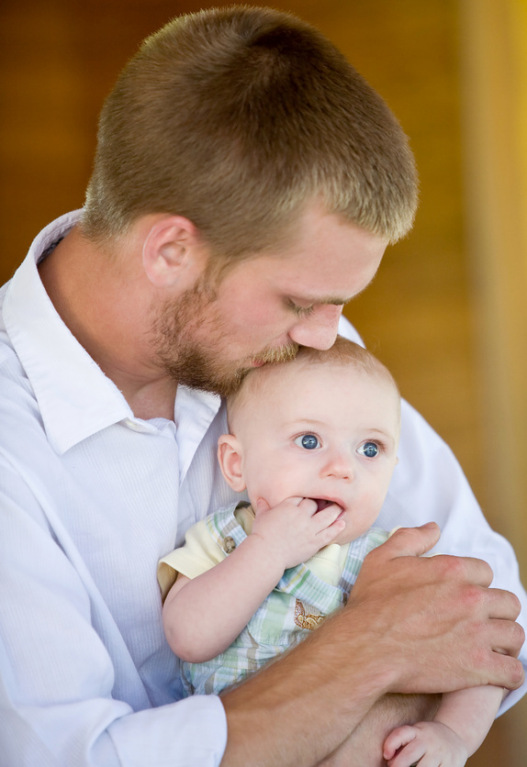
How to Help Caregivers Prevent Shaken Baby Syndrome-the 5 S’s
  Swaddling- re-create the womb by placing the baby’s arms by his side and wrap snug and cozy.
  Side/stomach –hold baby on side facing slightly forward. Once asleep always put the baby on his back.
  SHHHing-re-create the sound of the womb by making a “shhhh” sound in the infant’s ear at the same noise level as the crying. As the baby quiets, quiet the “shhhh”.
  Swinging – re-create womb movement by gently rocking the baby from side to side making sure that the infant’s head is supported.
  Sucking- Use a clean finger or pacifier and lightly pull to encourage the sucking reflex.

Slide 18
Resources for SBS/AHT
National Center on Shaken Baby Syndrome
www.DontShake.com
Center for Disease Control and Prevention
www.cdc.gov/concussion/HeadsUp/sbs
www.AboutShakenBaby.com
UAB Shaken Baby Prevention Program
Melissa C. Nelson
mnelson@peds.uab.edu
Parenting Assistance Line (PAL) 1-866-962-3030

Slide 19
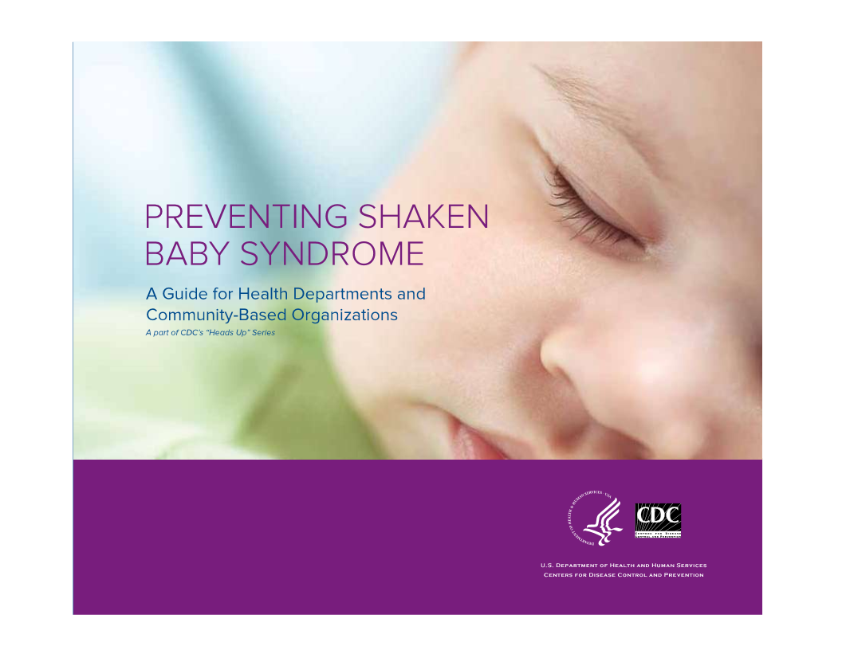
Specific Topic
cdc.gov/concussion/HeadsUp/sbs
Notes:
CDC’s Preventing Shaken Baby Syndrome publication from “Head’s Up” series.
http://www.cdc.gov/concussion/HeadsUp/sbs

Slide 20
General Resources
Alabama Resources
Centers of Disease Control
www.cdc.gov/traumaticbraininjury
Brain Injury Association of America
www.biausa.org
BrainLine.org
BrainInjuryEducation.org
University of Missouri TBI Guide
Lash and Associates Publishing
www.lapublishing.com
TraumaticBrainInjuryAtoZ.org
www.tbiGuide.com
UAB Model System
www.uab.edu/tbi
Alabama Head Injury Foundation
www.AHIF.org
Alabama Department of Rehabilitation Services www.rehab.alabama.gov/tbi
Mapping Access to Program Services www.rehab.alabama.gov/maps
Alabama Disabilities Advocacy Program
www.adap.net
Notes:
Other partners in the state that provide support and services to individuals with TBI and their families include….

Slide 21
Core TBI Service System
Alabama Head Injury Foundation
Interactive Community-Based Model
Vocational Rehabilitation Service
Children’s Rehabilitation Service
Notes:
Often when an individual with a brain injury or a service provider is at the crossroads trying to decide what the next step is in getting help to address the multitude of treatment or rehabilitation needs, they are unsure where to go for help.
There are many resources in the Core Statewide TBI Service System that provide needed services to individuals with brain injury from infancy to older aged citizens.
The Core System is made up of 20 traumatic brain injury experts, ready to assist individuals, their families and other service providers.
I’m going to give you an overview of the Core Statewide TBI Service System to help you better understand how to navigate the system.

Slide 22
Alabama Head Injury Foundation (AHIF)
…a state-wide non-profit with the mission to improve the quality of life for people who have survived traumatic brain injuries and for their families.
AHIF helps access available resources and provides services and programs which meet the unique needs of individuals with traumatic brain injury (TBI) as well as spinal cord injury (SCI) in certain programs.
Programs include:
Resource Coordination, Respite Care, Housing Assistance, Information and Referral, Camp Program, Recreation Program, Advocacy, Recreational Support Groups, Car Seats for Kids, Neurobehavior Clinic
For more information about AHIF, call 205-823-3818 or 800-433-8002, or email AHIF1@bellsouth.net.
Notes:
The Interactive Community-Based Model’s ultimate goal is improving the consumer’s readiness for services that lead to employment.
ICBM is implemented by 6 TBI Care Coordinators located throughout the state to provide services to assist with the reintegration of adults with a brain injury.
ICBM can be broken down into five phases.
This entire process incorporates consumer choice and may include psychosocial adjustment to the disability, TBI awareness and education, cognitive retraining, behavior management techniques, independent living skills and community integration.

Slide 23
Interactive Community-Based Model (ICBM)
A program within the Alabama Department of Rehabilitation Services
…an interactive, criterion-based program designed to address employability, independence and community reintegration for individuals with TBI.
To qualify the individual must:
be less than 2 years post-injury, which was a result of external force neurotrauma
not be appropriate for traditional vocational rehabilitation services at the time of referral
be able to benefit from a cognitive and behavioral rehabilitation program
Services may include:
Counseling and Guidance, Cognitive Remediation, TBI Education, Individual and Family Support, Case Management, Behavioral Program Development
For more information about ICBM, call 205-290-4590 or 888-879-4706, or email
maria.crowley@rehab.alabama.gov.
Notes:
The Interactive Community-Based Model’s ultimate goal is improving the consumer’s readiness for services that lead to employment.
ICBM is implemented by 6 TBI Care Coordinators located throughout the state to provide services to assist with the reintegration of adults with a brain injury.
ICBM can be broken down into five phases.
This entire process incorporates consumer choice and may include psychosocial adjustment to the disability, TBI awareness and education, cognitive retraining, behavior management techniques, independent living skills and community integration.

Slide 24
Children’s Rehabilitation Service (CRS)
A division within the Alabama Department of Rehabilitation Services
…to assist children and youth in transition from hospital to home, to school, and to the community.
Eligibility:
Any child or adolescent younger than 21 years of age who is a resident of Alabama and has a special health care need.
Services may include:
Information and Referral, Care Coordination, Treatment, Transportation Assistance, Community Education and Support,
Evaluation and Assessment, Family Education
For more information about CRS, Services,
call 1-800-441-7607 (TTY 1-800-499-1816) or contact the CRS office in your area.
www.rehab.alabama.gov
Notes:
Families of children with TBI are often unprepared for the issues involved with a child’s re-entry into activities at home, school, community. Due to the progression of growth/development, children/youth with TBI may have recovery needs that are discovered over time. A professional with knowledge of TBI and its impact on children is helpful to families during this time. CRS has 5 care coordinators to work with families of children/youth with TBI. CRS provides the following TBI services through PASSAGES: 1 Information and Referral, 2.Care Coordination, 3.Treatment, Related Services
Information and Referral Provides information about the effects of TBI and available resources, including medical treatment and neuropsychological evaluation, referral to appropriate specialists, local/state programs, and other resources.
Care Coordination Assesses needs of child/family, identifies/links to services, coordinates services with other agencies, authorizes/arranges services, and provides information on special education, including the IEP.
Treatment Upon verification of TBI , families may enroll their children into CRS / TBI services, which may include purchase of medications, supplies, functional/communication assessments and neuropsychological evaluations.
Related Services Provides family education; assistance with physical, occupational, and speech therapy; transportation assistance; and community education regarding TBI.

Slide 25
Vocational Rehabilitation Service (VRS)
A division within the Alabama Department of Rehabilitation Services
…provides services to eligible individuals with disabilities to improve opportunities for employment
To be eligible the individual must:
Have a physical or mental disability that inhibits obtaining or maintaining employment
Require vocational rehabilitation services in order to get or keep a job
*Eligibility is presumed for recipients of SSI or SSDI who intend to achieve an employment outcome.
Services may include:
Counseling and Guidance, Evaluation, Training Services, Job Placement , Assistive Technology, Supported Employment, Postemployment Services
For more information about VRS,
call 1-800-441-7607 (TTY 1-800-499-1816) or contact the VRS office in your area.
www.rehab.alabama.gov
Notes:
The Interactive Community-Based Model’s ultimate goal is improving the consumer’s readiness for services that lead to employment.
ICBM is implemented by 6 TBI Care Coordinators located throughout the state to provide services to assist with the reintegration of adults with a brain injury.
ICBM can be broken down into five phases.
This entire process incorporates consumer choice and may include psychosocial adjustment to the disability, TBI awareness and education, cognitive retraining, behavior management techniques, independent living skills and community integration.

Slide 26
Alabama Statewide TBI Core System
Core Service Programs
Includes AHIF; ADRS’ CRS, ICBM, and VRS
Alabama Head Injury Task Force
Board of statewide leaders with an interest in improving care for individuals with TBI
Impaired Drivers Trust Fund and Advisory Board
Facilitates Core system services and serves as last resort payer for costs of care for Alabamians with neurotrauma
Alabama Head and Spinal Cord Injury Registry
Service linkage system containing all head and spinal cord trauma reported by hospitals statewide
Notes:
**Notes not updated. (HC 11/4/11)**
Often when an individual with a brain injury or a service provider is at the crossroads trying to decide what the next step is in getting help to address the multitude of treatment or rehabilitation needs, they are unsure where to go for help.
There are many resources in the Core Statewide TBI Service System that provide needed services to individuals with brain injury from infancy to older aged citizens.
The Core System is made up of 20 traumatic brain injury experts, ready to assist individuals, their families and other service providers.
Overview of the Core Statewide TBI Service System to follow.

Slide 27
Core System Contacts
Maria Crowley
State Head Injury Coordinator
205-290-4590 or 888-879-4706
maria.crowley@rehab.alabama.gov
www.rehab.alabama.gov/tbi
Alabama Head Injury Foundation
205-823-3818 or 800-433-8002
ahif1@bellsouth.net
www.ahif.org

Slide 28

Supported in part by ALH21MC06738 from the Department of Health and Human Services Health Resources and Services Administration, Maternal and Child Health Bureau. The contents are the sole responsibility of the authors and do not necessarily represent the official views of DHHS.

Slide 29
References
Faul M, Xu L, Wald MM, Coronado VG. Traumatic brain injury in the United States: emergency department visits, hospitalizations, and deaths. Atlanta (GA): Centers for Disease Control and Prevention, National Center for Injury Prevention and Control; 2010; www.cdc.gov/TraumaticBrainInjury .
“Traumatic Brain Injury Provider Training Manual”. TBI Project. Michigan Department of Community Health. 2005.
"Traumatic Brain Injury Model Systems National Database Update". Traumatic Brain Injury Model Systems National Data and Statistical Center. www.tbindsc.org. 2011.
“BIAA Adopts New TBI Definition.” www.biausa.org. Feb 6 2011.
"Traumatic brain injury." Mayo Clinic Staff. www.MayoClinic.com. Mayo Foundation for Medical Education and Research. Sep 16, 2010.
"Injury Prevention & Control: Traumatic Brain Injury." Centers for Disease Control and Prevention. www.cdc.gov. Sep 21, 2011.
7 National Institute on Disability and Rehabilitation Research; www2.ed.gov.
8 www.cdc.gov/consuccions/HeadsUp/sbs

